Slide 1


Skin Disease Image Recognition Using (K-NN algorithm) Deep Learning
VEL TECH MULTITECH Dr.RANGARAJAN Dr.SAKUNTHALA ENGINEERING COLLEGE
Department of Computer Science Engineering

Slide 2
OBJECTIVE
The technology trend is moving towards replacing the human physical activity and unhealthy eating habits which hare directly linked to increasing the risk of having the skin diseases.
The goal of the project is to detect the person which may have a skin disease or not using the K-NN classifier Algorithm by overcoming the existing disadvantages such as less accuracy and takes more time for large dataset.

Slide 3
ABSTRACT
In the field of medicine, skin disease is one of the most common diseases, and its visual representation is more prominent compared with the other types of diseases.
We propose a skin disease image recognition method based on deep learning is better than those of dermatologists and other computer-aided treatment methods in skin disease diagnosis.
Especially the multi deep learning model fusion method has the best recognition effect.

Slide 4
EXISTING SYSTEM
Most of skin disease detection process approach CNN ( Convolution Neural Network )
But, CNN makes predictions by looking at an image and then checking to see if certain components are present in that image or not. If they are, then it classifies that image accordingly.
If the certain components are not present, then it will ignore the image and doesn’t classify it.

Slide 5
Literature Survey
Tanzina Afroz Rimi, Nishat Sultana and Md. Ferdouse Ahmed Foysal “Skin Diseases Detection Using Convolutional Neural Network” Daffodil International University, Dhaka, Bangladesh, 2020
In this article author’s proposed, Skin is the most powerful protection of important organs in the human body. It acts as a shield to protect our internal body to get damaged. But this important part of the human body can be affected by so serious infections caused by some fungus or viruses or even dust too. Around the world, millions of people suffer from various skin diseases.so they came up to predicting process with CNN classifier.

Slide 6
LING-FANG LI, XU WANG, NEAL N. XIONG, YONG-XING DU AND BAO-SHAN LI “Deep Learning in Skin Disease Image Recognition: A Review” Inner Mongolia University of Science and Technology, Baotou 014010, China, 2020
In this study, we review 45 research efforts on the identification of skin disease by using deep learning technology since 2016. Author’s analyze these studies from the aspects of disease type, data set, data processing technology, data augmentation technology, model for skin disease image recognition, deep learning framework, evaluation indicators, and model performance. For Prediction used K-NN classifier.

Slide 7
Kumar, N. V., Kumar, P. V., Pramodh, K., & Karuna, Y. (2019). “Classification of Skin diseases using Image processing and SVM”. 2019
In this study, Recently, it is well known that, the most dangerous form of skin cancer among the other types of skin cancer is melanoma because it is much more likely to spread to other parts of the body if not diagnosed and treated early. In order to classify these skin diseases, “Support Vector Machine (SVM)” a Machine Learning Algorithm can be used.

Slide 8
PROPOSED SYSTEM
In our proposal , We use the concept of Python - Flask and we are implementing with the help of Scikit-Learn & Pandas (SciPy Toolkit) in python.
Prediction accuracy is high, robust working when training datasets contain errors.
For separation of (disease affected skin and healthy skin),We use the concept of on K-NN classifier algorithm

Slide 9
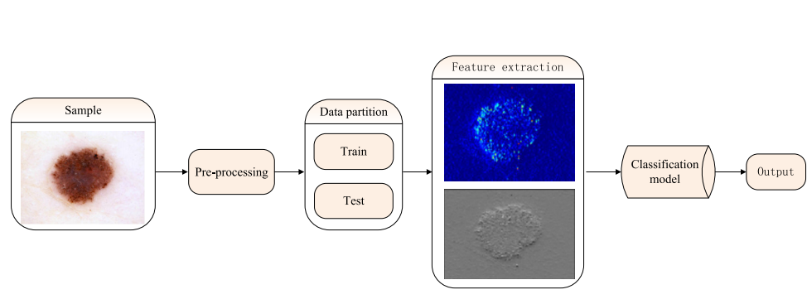
Deep Learning in Skin Disease Image Recognition flow :

Slide 10
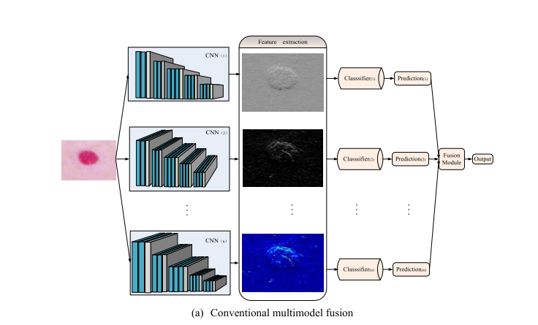

Slide 11
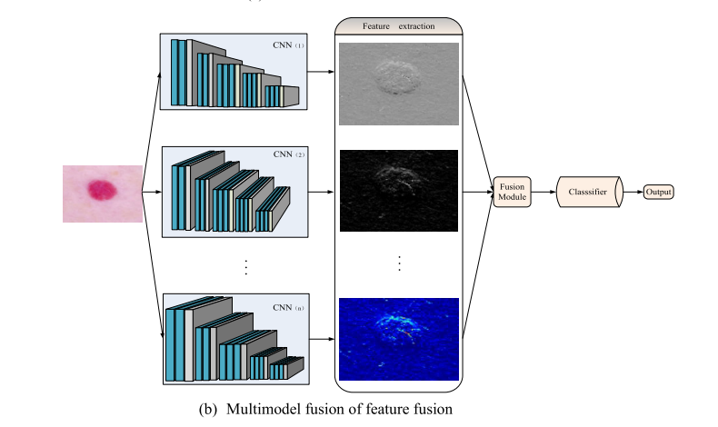

Slide 12
Algorithms used
k-nearest neighbors (KNN) Algorithm
The k-nearest neighbors (KNN) algorithm is a simple, supervised machine learning algorithm that can be used to solve both classification and regression problems. It's easy to implement and understand, but has a major drawback of becoming significantly slows as the size of that data in use grows.

Slide 13
DISADVANTAGES OF EXISTING SYSTEM:
Less accuracy
Slow learner, not robust to the noise data in large training example.
Require large storage space and more time.
ADVANTAGES IN PROPOSED SYSTEM:
Prediction accuracy is high.
Robust working when training datasets contain errors.
High speed, preferable in limited precision.

Slide 14

Output For Process flow
a) Login for skin disease application

Slide 15
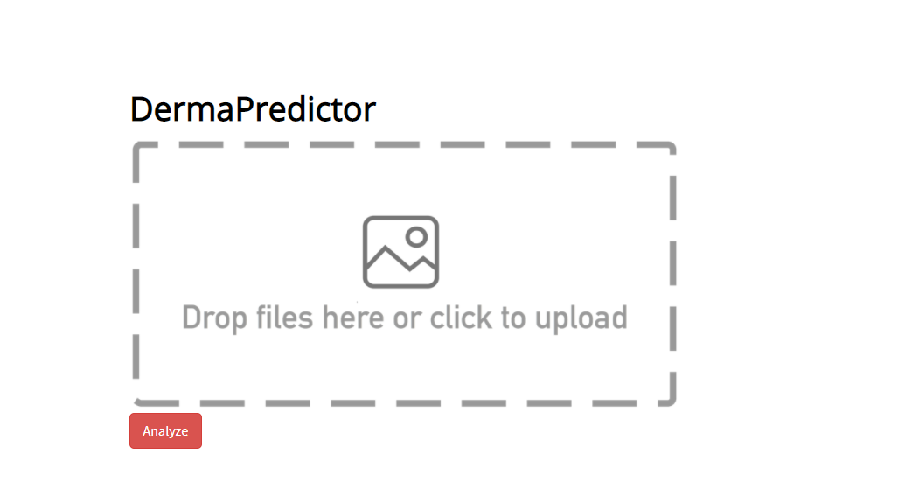
Output For Process flow
b) Before selecting analyzing image

Slide 16
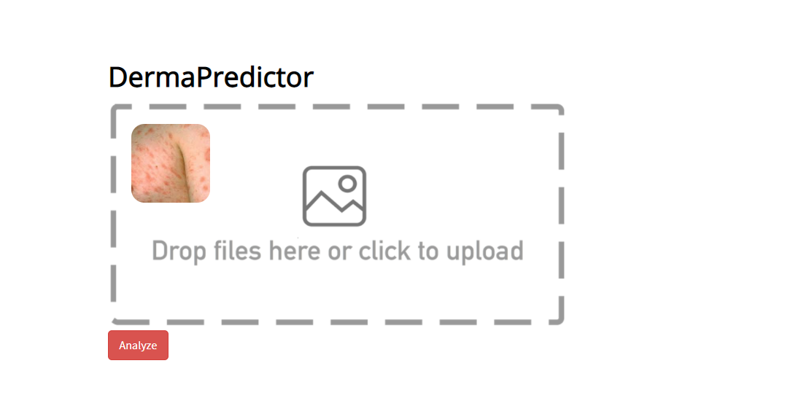
Output For Process flow
c) After selecting analyzing image

Slide 17

Output For Process flow
c) Final resultant output

Slide 18
References
Tanzina Afroz Rimi, Nishat Sultana and Md. Ferdouse Ahmed Foysal “Skin Diseases Detection Using Convolutional Neural Network” Daffodil International University, Dhaka, Bangladesh, 2020
LING-FANG LI, XU WANG, NEAL N. XIONG, YONG-XING DU AND BAO-SHAN LI “Deep Learning in Skin Disease Image Recognition: A Review” Inner Mongolia University of Science and Technology, Baotou 014010, China, 2020.
Kumar, N. V., Kumar, P. V., Pramodh, K., & Karuna, Y. (2019). “Classification of Skin diseases using Image processing and SVM”. 2019

Slide 19
Software Requirements
Software Tool : Python – Flask
Required Python Modules: Matplotlib, Sci-Py, Pandas, Numpy, Coloroma
Operating System : Windows 10
Processors: Intel or AMD
RAM : 4 GB
Graphics card: No Graphics card required

Slide 20
Thank you!!!

